Slide 1






How to Find Your Friendly Neighborhood Graph Attention Design with Self-Supervision
ICLR 2021
Code: github.com/dongkwan-kim/SuperGAT
2021.03.02 • ChongQing
Reported by Chenghong Li

Slide 2
Introduction
GATs are inconsistent in the degree of improvement across datasets, and there is little understanding of what graph attention actually learns.
We propose SuperGAT with the idea of guiding attention with the presence or absence of an edge between a node pair.
We exploit the link prediction task to self-supervise attention with labels from edges: for a pair i and j, 1 if an edge exists and 0 otherwise.

Slide 3

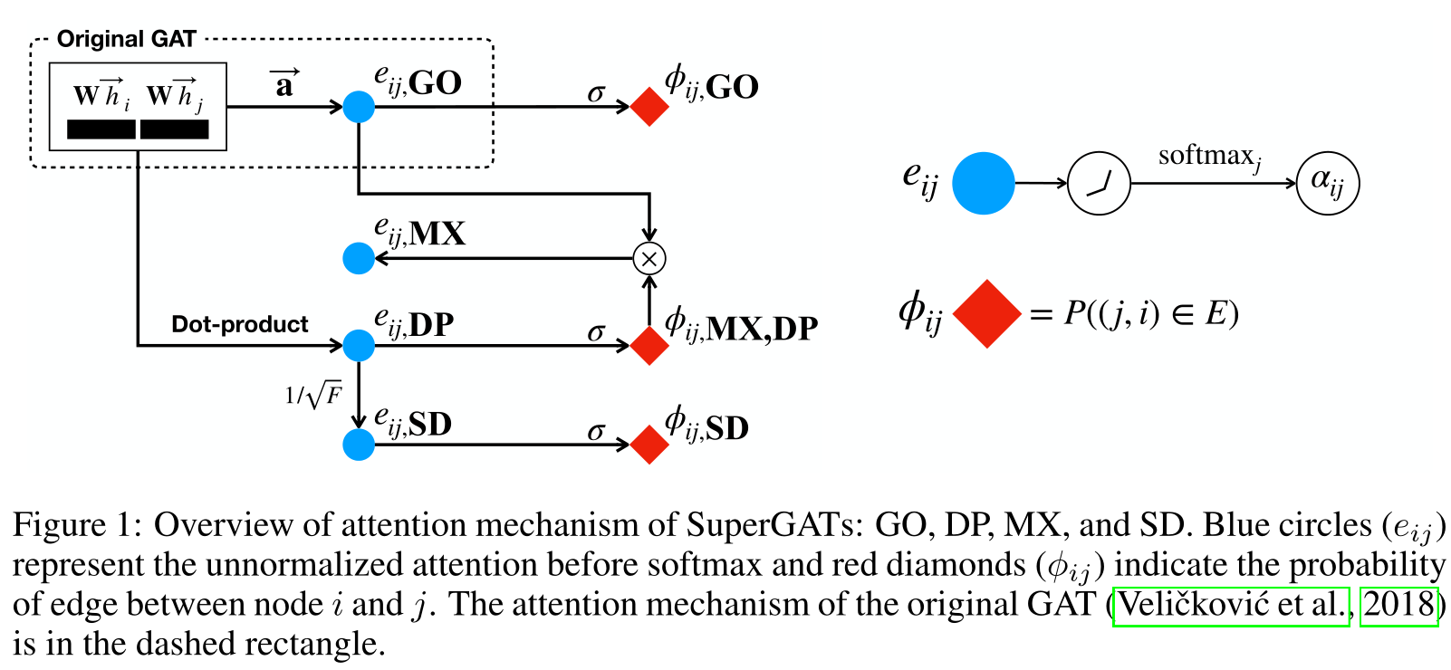

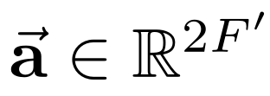
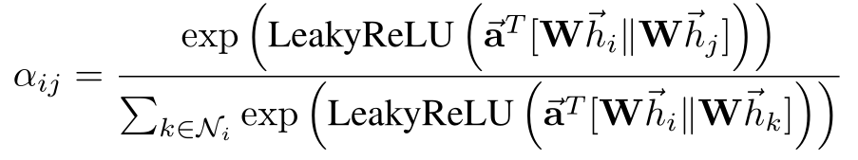
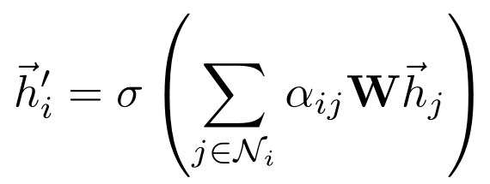
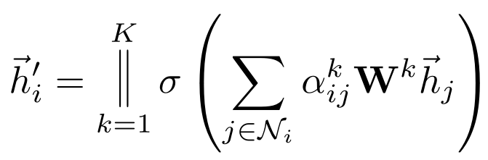
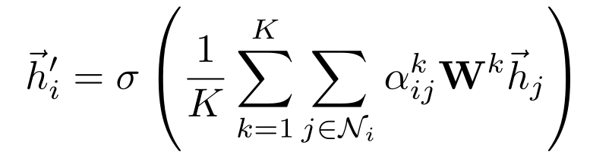
Method

Slide 4
Method
MX: Mixed GO and DP
DP: Dot-product
SD: Scaled Dot-product

Slide 5
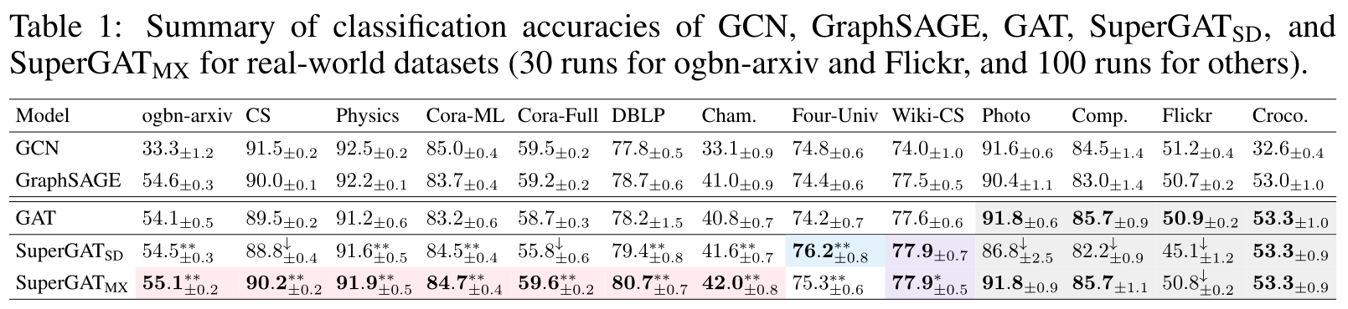
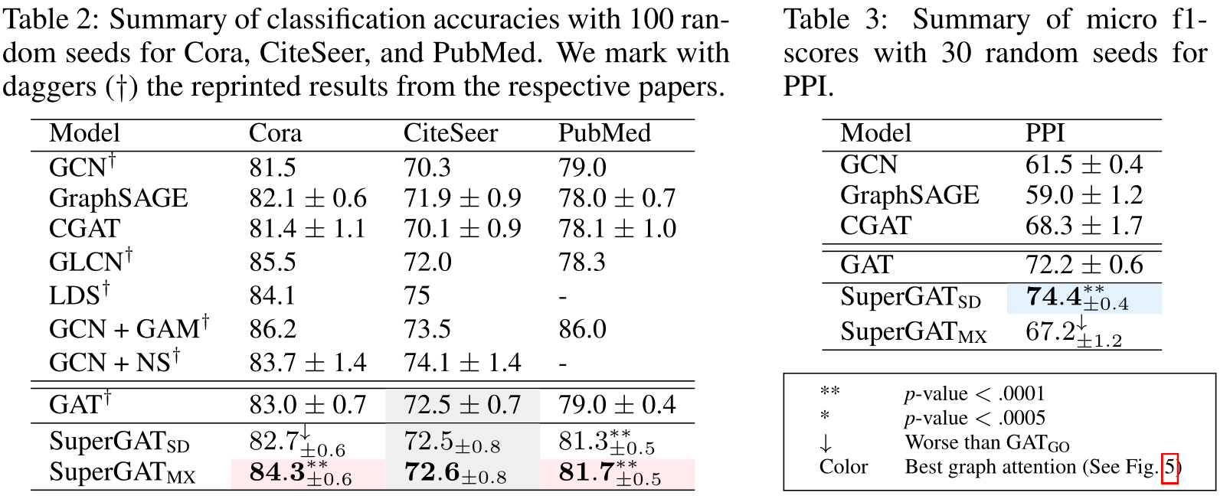
Experiments

Slide 6
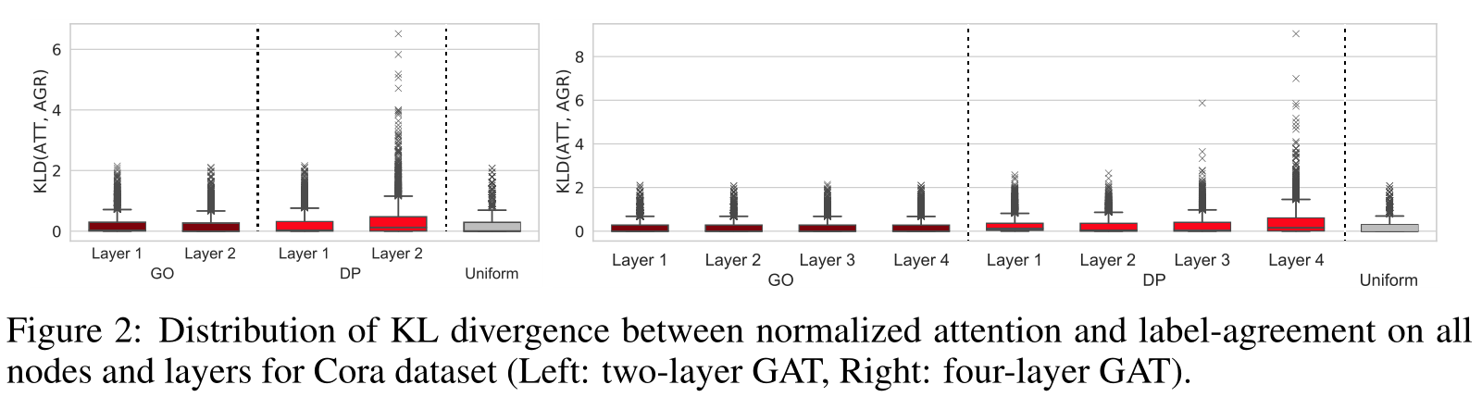
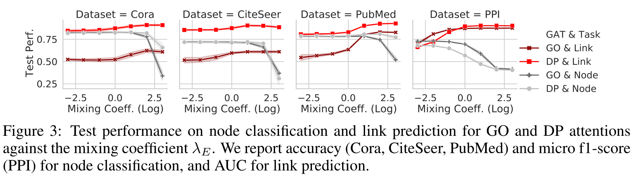
Experiments

Slide 7
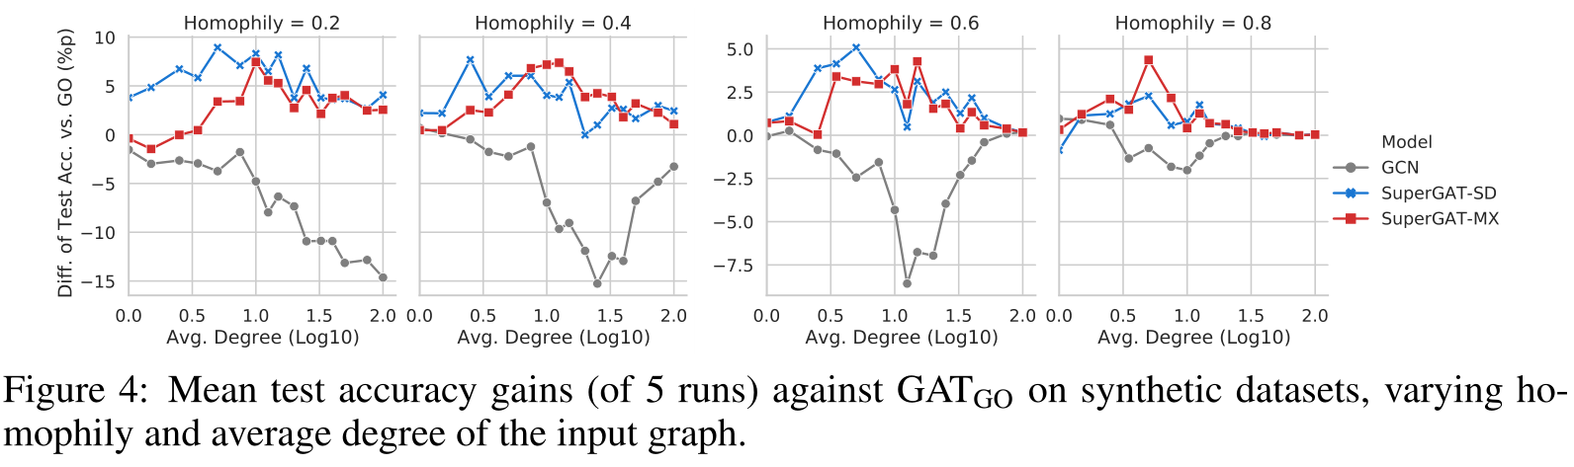
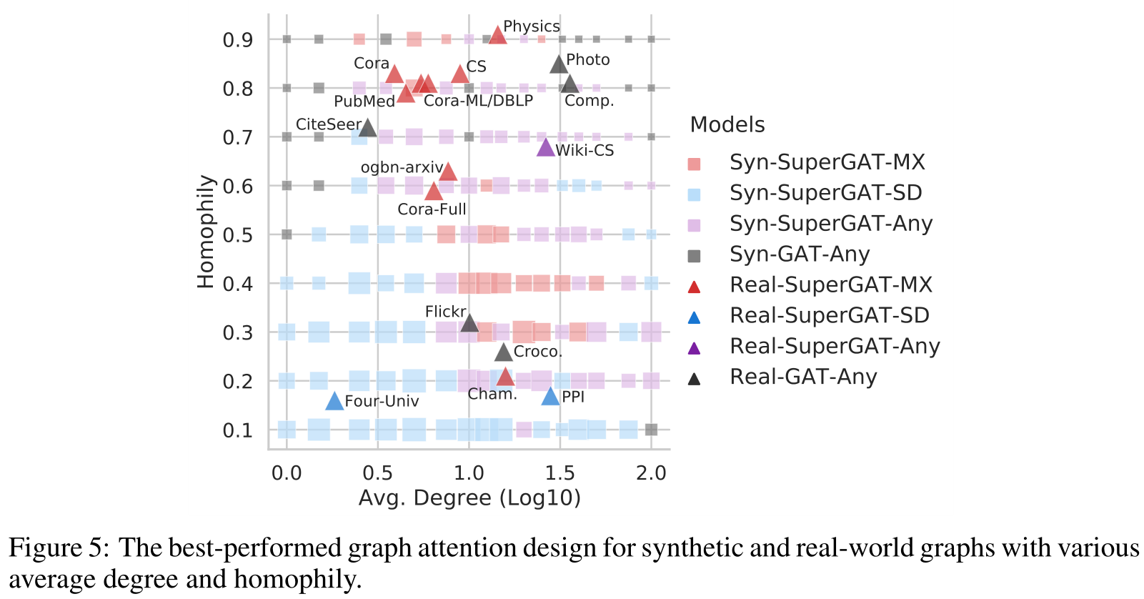
Experiments

